Slide 1




SIMPLY PETS
www.Simplypets.com

Slide 2

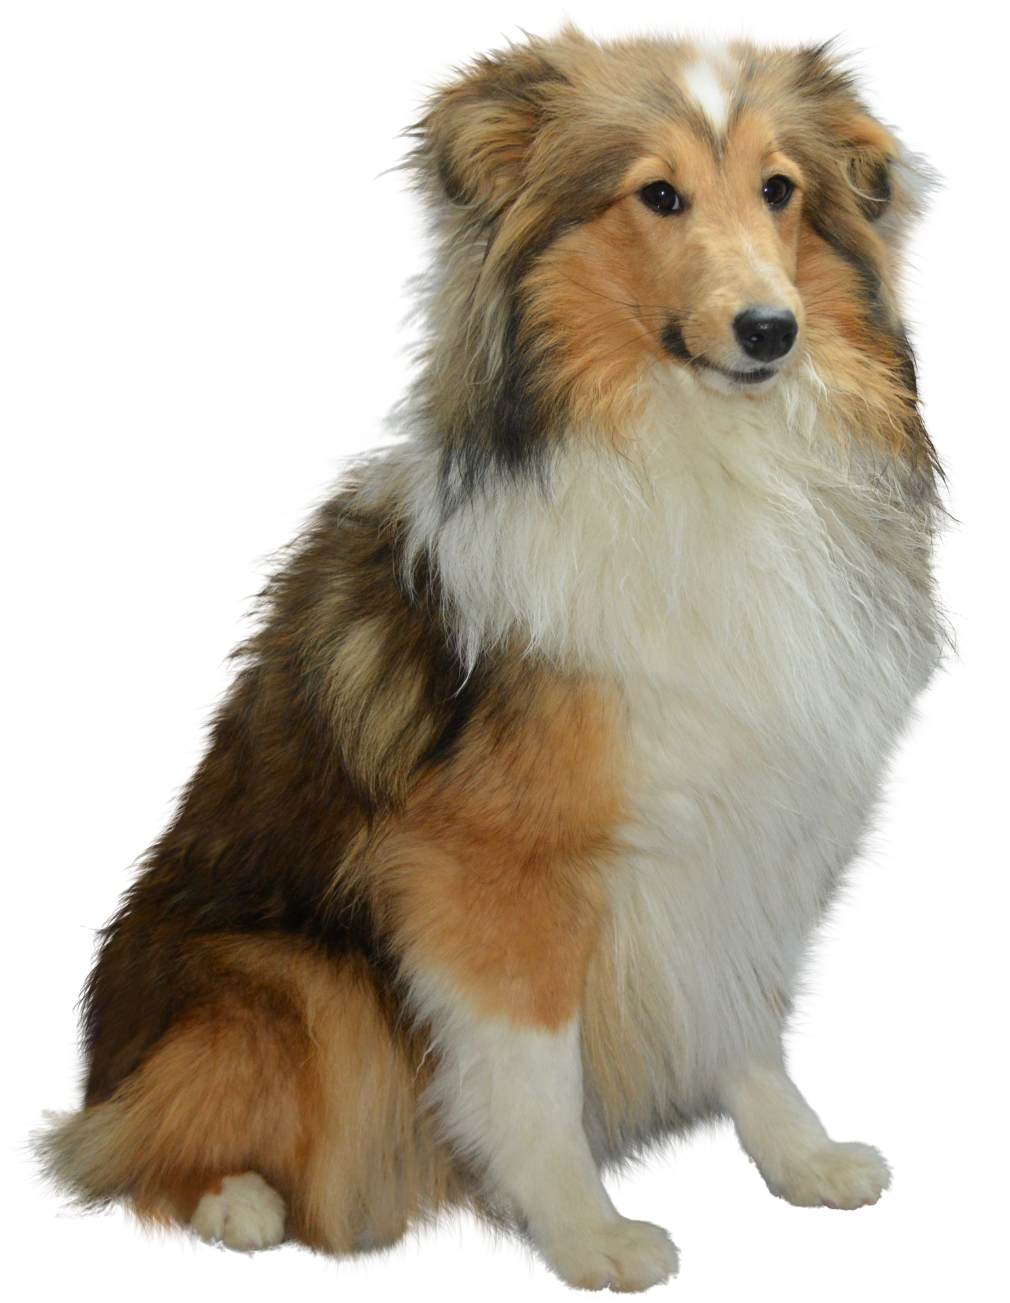


OVERVIEW
ABOUT US
DESIGN OVERVIEW
CAT DEPARTMENTS
USER JOURNEY (FLOWCART)
DOG DEPARTMENT
DESIGN TOOLS
EXOTIC DEPARTMENT
HAPPY CUSTOMERS
CONTACT

Slide 3


ABOUT US
At Simply Pets, we’re proud to be more than just a pet supply store.
We’re a place where pet lovers come together to care, connect, and celebrate.
Our products are chosen with love and tested for comfort, safety, and joy.
From playful pups to senior cats, we’ve got something for every stage of life.

Slide 4
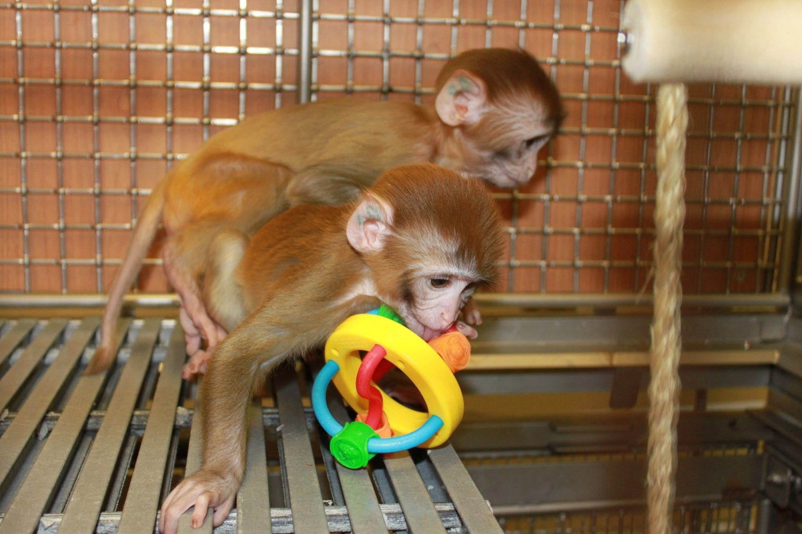
Design Overview
Modern, minimal design with soft color palette.
Animal-themed icons, friendly fonts, and large visuals.
Emphasis on featured products and seasonal promotions.
Organized categories: Food, Toys, Grooming, Health, Accessories.
Accessibility-friendly with readable text and alt image tags.

Slide 5
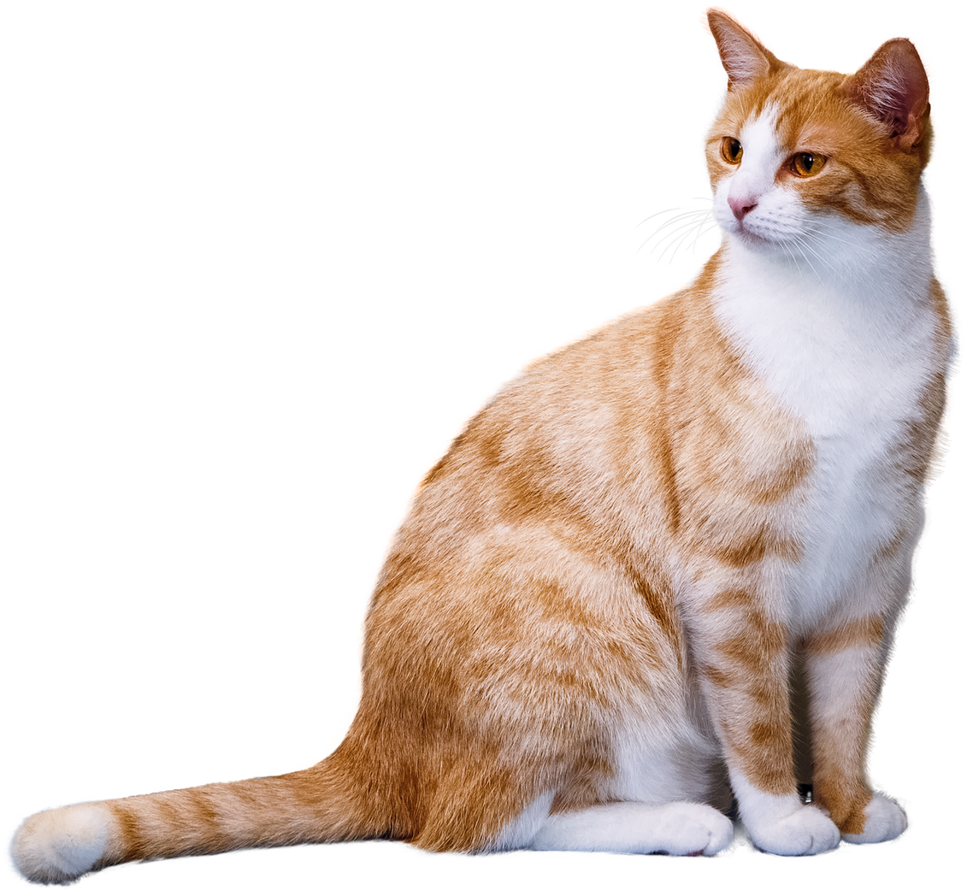
CAT DEPARTMENT
Cat food
Cat training
Cat beds
Cat grooming
Cat toys
Medicine

Slide 6
Flowchart- User Journey
Start
Home Page
Book Services
Pet Details
Add to Chart Chart
Choose Service
Checkout
Select Time
Confirm
Shop Products
View Pets

Slide 7
DOG DEPARTMENT
Dog food
Dog training
Dog bed/cages
Dog grooming
Dog toys
Medicine

Slide 8
Design Tools
Frontend: HTML, CSS, JavaScript (React.js)
Backend: Spring Boot (Java Framework)
Database: MySQL or PostgreSQL (for structured product, user, and order data)
REST API: Developed using Spring MVC controllers
Security: Spring Security with JWT for authentication
Payment Integration: Stripe / PayPal APIs
Hosting:
Frontend: Vercel / Netlify
Backend: Render / Heroku / AWS Elastic Beanstalk

Slide 9
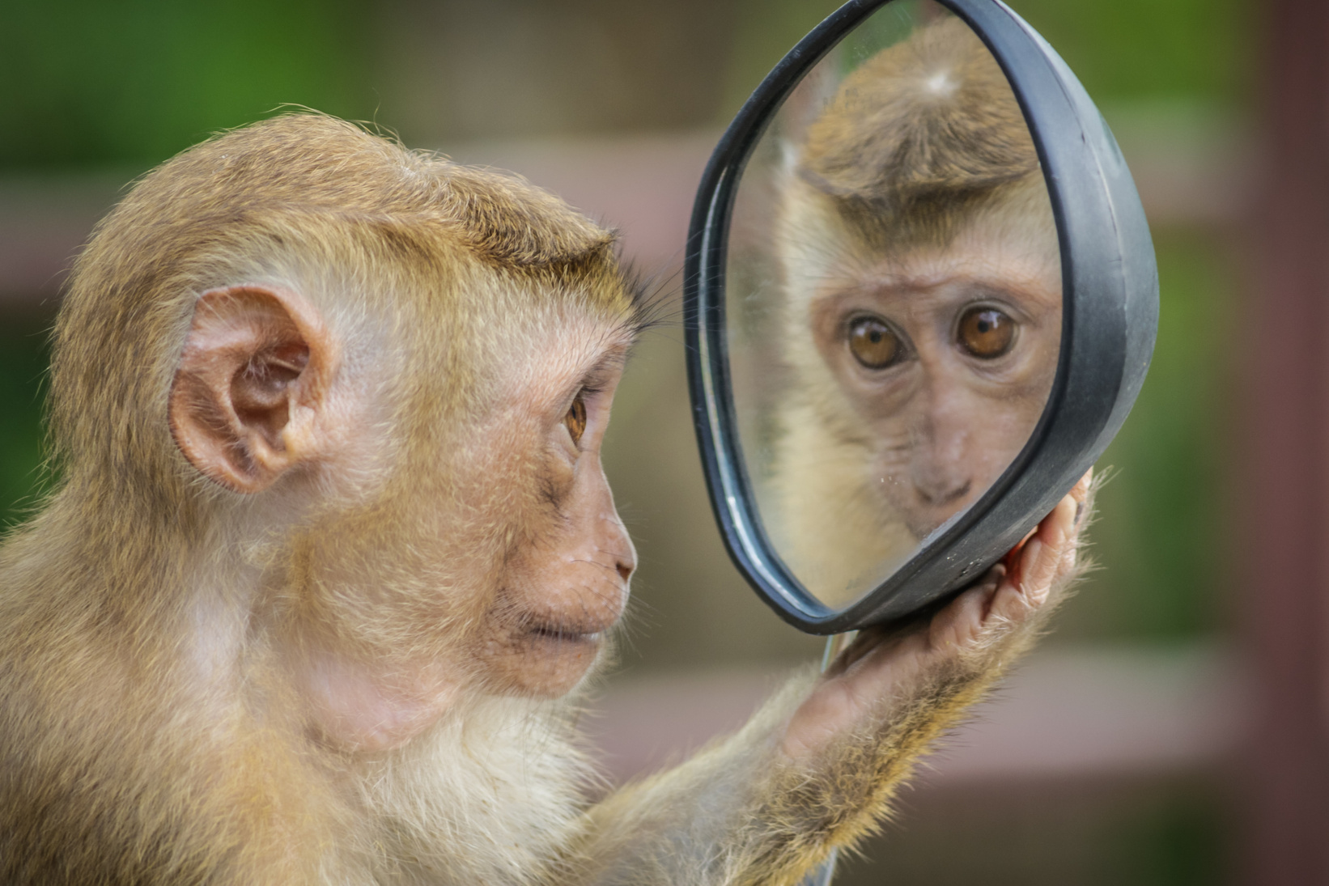
EXOTIC DEPARTMENT
Cages
Training
Food
Grooming
Toys
Medicine

Slide 10
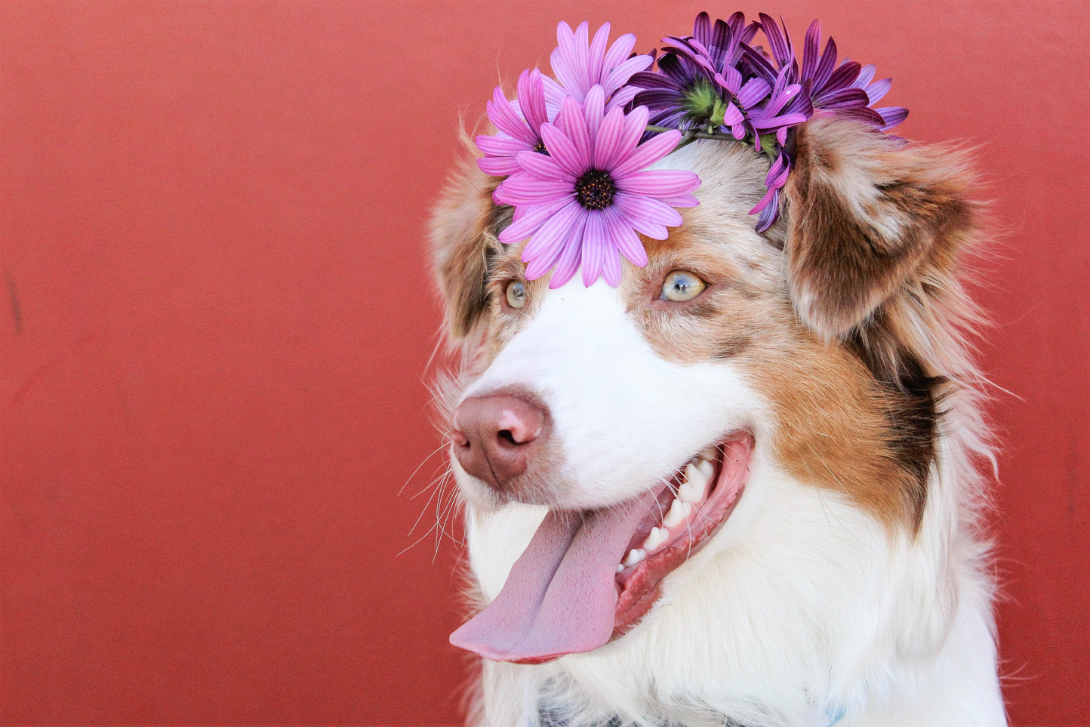

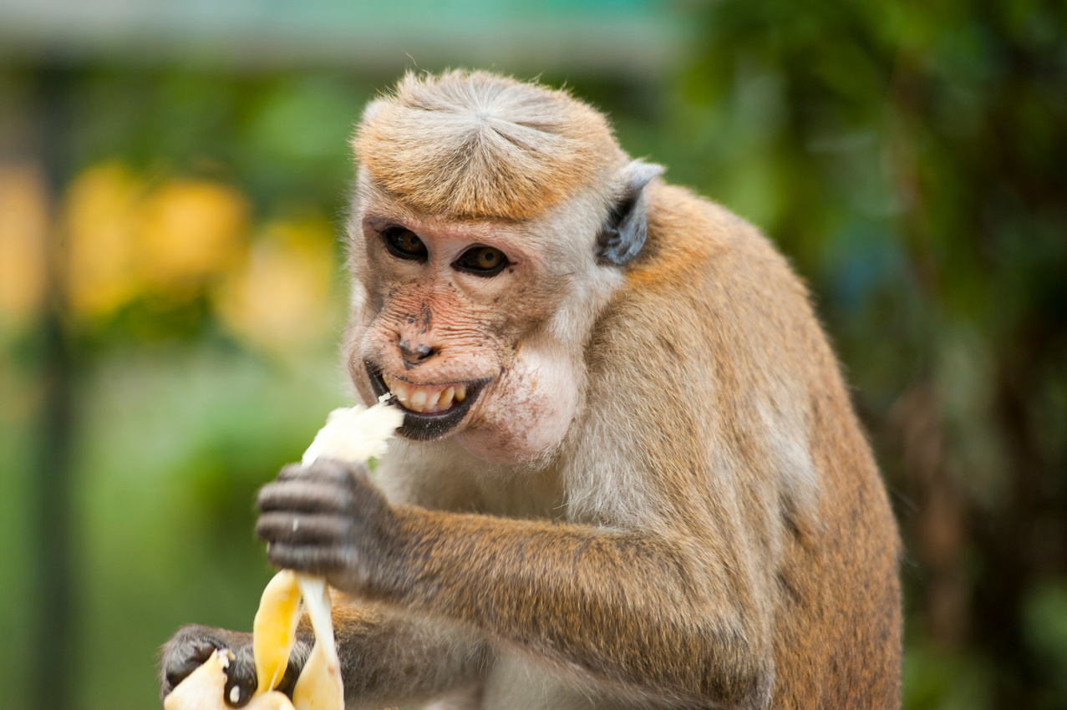
HAPPY CUSTOMERS
Claudia Alves
Samira Hadid
Aaron Loeb
A presentation is a formal or informal communication method
A presentation is a formal or informal communication method
A presentation is a formal or informal communication method

Slide 11
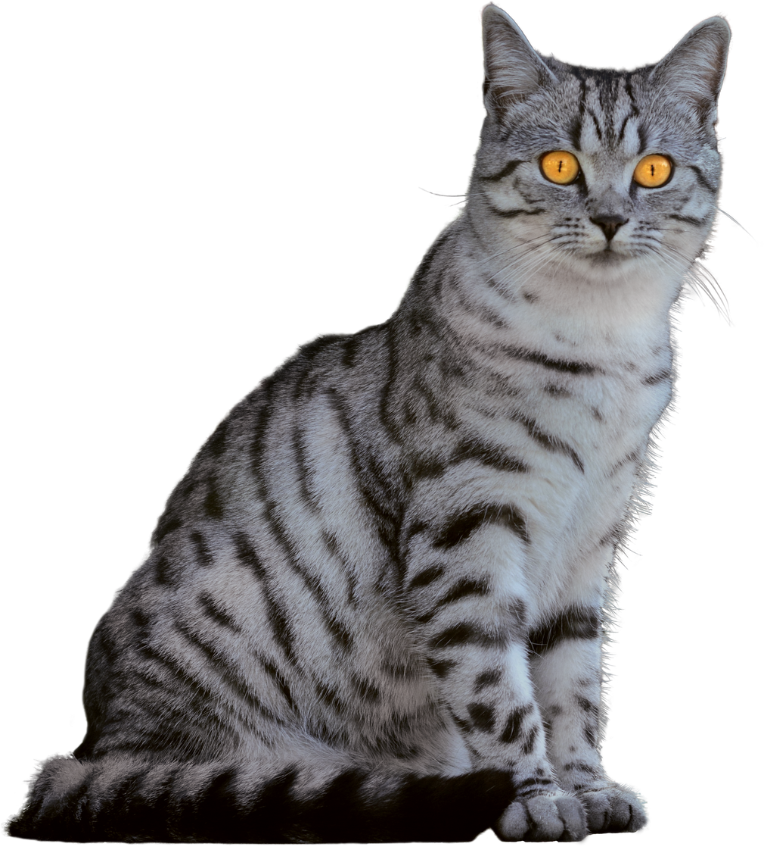
CONTACT
E-mail
SP@gmail.com
Website
www.simplypets.com
Phone
+123-456-7890
Address
123 We care St., Dallas, TX 12345

Slide 12
THANK YOU
www.simplypets.com

